Slide 1
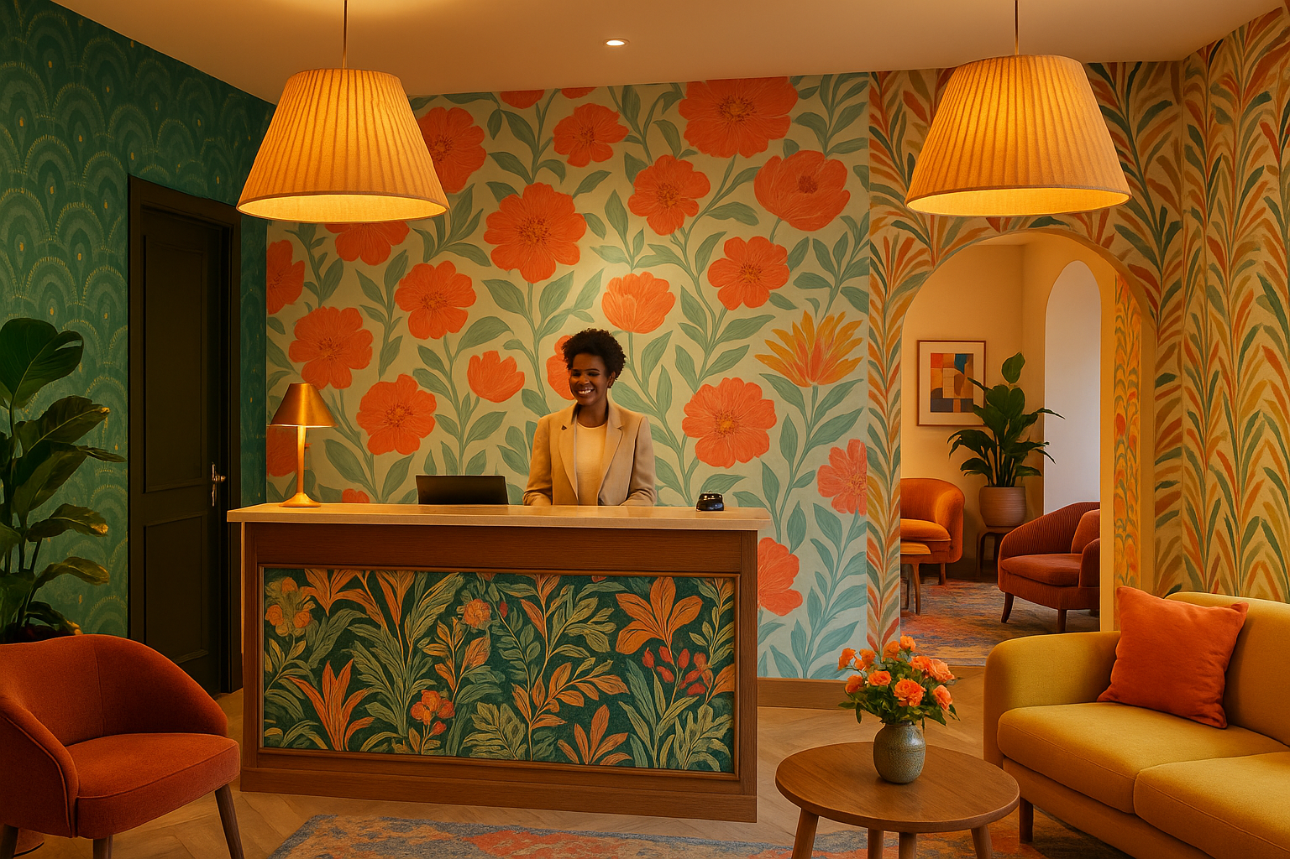

HOSTING LARGE ASSOCIATION CONFERENCES HOTEL CHARTER

Slide 2

HOTEL CHARTER
In order to facilitate the hosting of conferences, local players in the business tourism sector have set up a system to facilitate the organization of major international events for the pre-booking and purchase of hotel rooms and to respond appropriately to the needs of the organizers of these events.
The destination has committed to a sustainable tourism strategy for 2030. A member of the GDS (Global Destination Sustainability Index) since 2019 with a score of 84% in 2025, the Convention Bureau assists clients in organizing responsible events in the region.
Particular attention is paid to hosting major professional events through the Welcome By Onlylyon program set up for targeted events (reception and directional signage).
With the second largest hotel capacity in France (19,400 rooms in hotels and tourist residences), the Convention Bureau works with a dedicated tool that facilitates the search for rooms, making it easier to assess the feasibility of events.

Slide 3
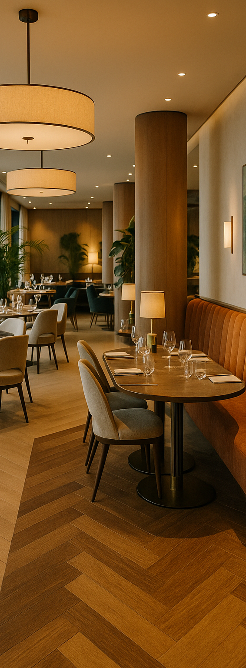
HOTEL CHARTER
PREAMBLE
The Hotel Charter (hereinafter referred to as “the Charter”) applies exclusively to any new event organised by non-profit organisations (learned societies, federations, professional associations, etc.) involving more than 1,000 room nights over at least one night and requiring bookings across several hotel establishments.
The Charter applies to congresses* for which the Convention and Visitors Bureau (hereinafter referred to as “the CVB”) must, several years in advance, submit the city of Lyon’s bid in order to secure the event.
The Charter reflects the moral commitment of establishments affiliated with the Convention Bureau; failure to comply with the commitments submitted may not give rise to any contractual or legal sanction.
OBJECTIVES
- To formalize an attractive destination policy for major association congresses;
- To provide the end client with a coherent and consolidated offer to facilitate the purchase of the destination;
- To guarantee a long-term portfolio of events for the destination.
*A congress is an event:
initiated by one or more scientific or technical organizations, involving financial participation from delegates, during which participants from different backgrounds come together at a specific time and place, with high educational added value, whose objective is the dissemination and exchange of knowledge and the sharing of experience on a given theme among specialists in the same discipline, generally held at a fixed frequency.

Slide 4

HOTEL CHARTER
Article 1. VALIDITY OF THE CHARTER
This Charter applies to all hotels affiliated with the Convention and Exhibition Bureau for a period of three consecutive years starting from 1 January 2026.…
Article 2. WELCOME: QUALITY COMMITMENT
The hotelier must provide any non-French-speaking client with an English translation of the
contract.
- Where applicable, the hotelier must provide written notification of any renovation work planned between the signing of the contract and the date of the event that may affect hotel guests.
- In the event of a change of brand or owner, the hotelier undertakes to transfer all of its contractual obligations to the new owner in order to comply with the terms of the contract.
Article 2.1 WELCOME COMMITMENT
- The hotelier undertakes to install signage reflecting the image of the congress at the “desk”: the CVB will provide hotels with a plexiglass display stand as well as the visual to be printed for each relevant event.
- The hotelier shall ensure the display of transport options in the lobby to access the congress and shall provide all information necessary for the use of sustainable mobility options.
Article 2.2 COMMITMENT TO SUSTAINABLE DEVELOPMENT
The hotel is committed to sustainable development through the implementation of an eco-responsible label, certification, or a charter of best practices such as:
- Program to reduce single-use plastics (plastic bags, water bottles, etc.)
Program to combat waste and wastefulness
Promotion of short supply chains and local products- Integration of people with disabilities, gender equality, equal opportunities, non-discrimination

Slide 5

HOTEL CHARTER
Article 3. HOTEL COMMITMENTS
Article3.1 HARMONIZATION OF THE OFFER
The hotelier undertakes not to offer more attractive rates on booking channels than those negotiated for the conference, until the last date of retrocession under legal terms and conditions of sale.
The hotelier undertakes to make available 50% of the establishment's capacity if it has fewer than 100 rooms and 60% if it has more than 100 rooms.
The hotelier undertakes to offer rates inclusive of tax per room per night, with tourist tax charged separately, and to state whether breakfast is included.
The hotelier undertakes to offer identical rates for double rooms and single rooms and to maintain an identical rate for each night of the Congress, regardless of the length of stay.
The hotelier undertakes to provide free accommodation for accompanying spouses, with breakfast included at no extra charge. Free accommodation for spouses applies to double rooms only (no free accommodation for a second person in a twin room). Accompanying spouses will only be liable for the individual tourist tax.
For pre- and post-conference weekend reservations, the best promotional rate will be applied under the same conditions.
The hotelier undertakes to provide firm and final rates when the rate request is made less than 12 months before the date of the event. If the request is made more than 12 months before the date of the event, the hotelier undertakes not to increase the advertised rate by more than 3% per year.
The hotelier agrees to offer one free night for every five nights purchased.

